Slide 1

CREDIT SCORE PREDICTION
Presenter : Basabdatta Ray

Slide 2
Business Objective
Introduction:
A German banking institution needs to conduct a risk analysis by understanding the loan applicant’s profiles whenever the bank receives any loan application. The bank has to make a decision regarding whether there is a risk of ‘Bad credit’ or not. Two types of risks are associated with the bank’s decision: ‘Good credit’ and ‘Bad credit’.
Problem Definition:
If the applicant is a good credit risk, i.e. he/she is likely to repay the loan, then not approving the loan to the person results in a loss of business to the bank.
If the applicant is a bad credit risk, i.e. he/she is not likely to repay the loan, then approving the loan to such a person results in a financial loss to the bank.
As a data analyst, I need to discover the differences between the 2 profile of the customers - customers who are ‘Bad credit’ and customers who are not.
Impact Of The Study:
Accurate prediction of the ‘Good credit’ customers will help in achieving business growth and more revenue.
Accurate prediction of the ‘Bad credit’ customers will minimize the loss to the business.

Slide 3
About The Data
Data Source and Description: (UCI Machine Learning Repository)
Attribute 1: (qualitative) Status of existing checking account | Independent variable
Attribute 2: (numerical) Duration in month | Independent variable
Attribute 3: (qualitative) Credit history | Independent variable
Attribute 4: (numerical) Credit amount | Independent variable
Attribute 5: (qualitative) Savings account/bonds | Independent variable
Attribute 6: (qualitative) Present employment since | Independent variable
Attribute 7: (numerical) Installment rate in percentage of disposable income | Independent variable
Attribute 8: (qualitative) Personal status and sex | Independent variable
Attribute 9: (numerical) Present residence since | Independent variable
Attribute 10: (numerical) Age in years | Independent variable
Attribute 11: (qualitative) Other installment plans | Independent variable
Attribute 12: (numerical) Number of existing credits at this bank | Independent variable
Attribute 13: (qualitative) Job | Independent variable
Attribute 14: (qualitative) status | Dependent variable

Slide 4
Project Workflow:
Phase-1: Business understanding
Identify the business problem clearly. Once the problem statement is defined then convert it to analytical problem.
Phase-2: Data Gathering
Once the business problem is framed ready for data ingestion from the organization sources (Data repository, file, DB, real-time streaming data, sensor data from IoT).
Phase-3: EDA
This phase is all about how well we can understand the data and hence, is the most time consuming and critical phase of the entire data science life-cycle.
Phase-4: Data pre-processing
Cleaning the raw data so that it can be used to train the ML model. We need data pre-processing to achieve good results from the model.
Phase-5: Model building
Researching the model that will be best for the type of data. Main goal is to train the best possible model using the pre-processed data.
Then split the data into 3 three sections - Training data ,Validation data and Testing data. Train the model using training data set, tune the parameters using validation set and finally then test the performance of the model on the unseen test data set.
Phase-6: Model evaluation
It is an integral part of the model development process. It helps to find the best suitable model that represents the data and how well the chosen model will work in the future.

Slide 5
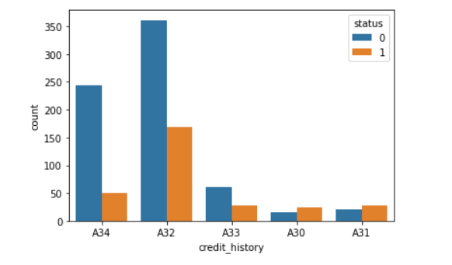
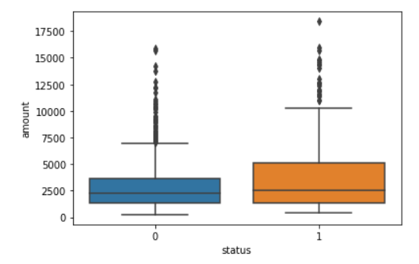
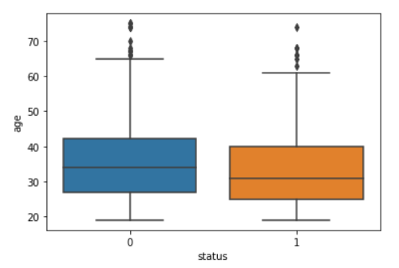
EDA Visualization:
‘credit_history’ vs ‘status’:
‘amount’ vs ‘status’:
‘age’ vs ‘status’:

Slide 6
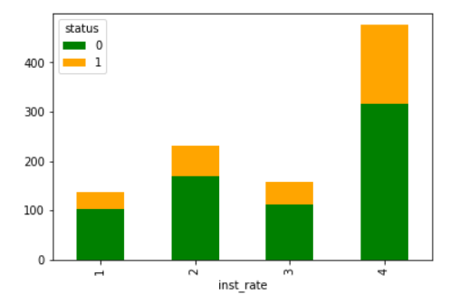
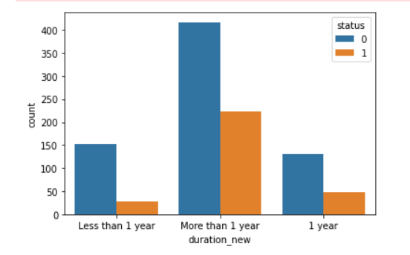
EDA Visualization:
‘inst_rate’ vs ‘status’:
‘duration_new’ vs ‘status’:

Slide 7
Key takeaways From EDA:
Question1: Find correlation among the input variables?
From the heatmap it seems that credit amount has a strong negative correlation with interest rate.
At the same time, amount has a moderate positive correlation with loan re-payment duration. If the credit amount is high then the duration to pay the loan will be longer.
Question2: How a customer’s previous credit history can impact his/her credit score?
From the statistical test we can conclude that credit history may be associated with a customer’s credit score. Customers who have paid back duly till date are less likely to become ‘Bad credit’, whereas the customers who are borrowing loan from the bank for the very first time are likely to become ‘Bad credit’.
Question3: Is Loan Duration & status related or not?
Here duration is the length of time it will take for a loan to be completely paid off by the borrower. It seems that most of the loanee have taken the loan from this bank for more than 1 year duration. And the customers have ‘Bad credit’ history where the loan duration is more than 1 year. So, high loan duration may be a risk factor for business.
Question4: Is there any impact of loan amount on status?
The data clearly indicates that higher the loan amount higher the risk. It seems that the 75% of the ‘Bad credit’ the loan amount is below 5500$. Whereas, for ‘Good credit’ the 75% of the loan amount is less than 3750$.
Question5: How a customer’s personal profile is significant for the target feature?
Half of the loan borrowers from this bank are Male customers who are single. And from the analysis it seems they are most likely to become 'Bad credit’ in comparison to other customers with different personal profiles. So, bank may want to take more granular look at a customer’s personal profile while approving a loan.
Question6: Can age of a customer impact his/her credit score?
The data clearly indicates that 50% of the 'Bad credit' customers are younger than the 50% of the 'Good credit' customers. So, 'age' may be considered a risk factor.

Slide 8
Feature Selection:
Based on correlation matrix and EDA few of the features which may be significant for this study are as following:
Age of the customer
Previous credit history of a customer
Credit amount
Loan payment duration
Customer’s personal status such as gender, marital status
Number of existing credits at this bank

Slide 9
Model Buidling:
Model building approach followed:
The risk prediction is a standard supervised classification real-time problem. So, applied supervised learning approach for the modelling.
Here the label is a binary variable, 0 ('Good credit' indicating no risk and loan will be paid on time), 1 ('Bad credit' indicating risk and hence difficulty repaying loan).
Used Logistic Regression and Tree based modelling.
At first created the baseline models.
Out of all the baseline models whichever meets the objective of this project will be tuned further in order to seek the best hyperparameters and to improve the model's predictive power.
Model | Accuracy | Recall | F1-Score | AUC
Logistic | 78% | 45% | 55% | 0.69
Decision Tree | 74% | 67% | 61% | 0.72
Random Forest | 77% | 30% | 43% | 0.65
XGBoost | 76% | 37% | 47% | 0.68

Slide 10
Model Performance and Evaluation:
The objectives of the study:
1. Minimize the risk, which can be ensured by high prediction accuracy of the model.
2. Maximize the revenue to the bank, which can be ensured by prompt re-payment of the loans.
To achieve both, we not only have to ensure high prediction accuracy of both Good and Bad credits,
we also need to minimize the mis-classification of good ratings as bad, and the vice versa. But the important point to note here is, that if the model wrongly classified an actual ‘Bad credit’ customer as a ‘Good credit’ customer, then in such case this error is more expensive for business. So, We need more focus on minimizing the False Negatives (or achieve high Recall).
Model Evaluation Metrics : Recall, Accuracy and AUC
Among all the models Decision Tree model is giving the highest Recall for the positive class after doing hyper parameter tuning and the accuracy is also good in comparison to other models.
Out of total predictions 74% of the predictions are accurately done by this model.
Out of total actual positive classes 67% of the time DT model is accurately predicting those as positive class. Hence, Recall is also high for both the class.
AUC for this model is the highest among all the models.
So, Decision tree model may be a good choice for this given dataset and the problem statement.

Slide 11
Thank you

